Slide 1
Resistors in series and parallel

Slide 2
Resistors in series
When two or more resistors are connected end to end, they are said to be in series. The resistors could be simple resistors or bulbs or heating elements or other devices
The three resistors R₁, R₂ and R₃ connected in series.
The amount of charge passing through resistor R₁ must also pass through resistors R₂ and R₃ since the charges cannot accumulate anywhere in the circuit

Slide 3
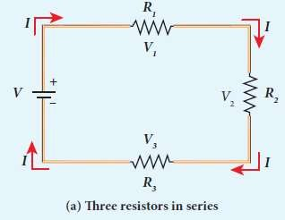

Slide 4
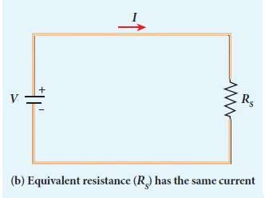

Slide 5
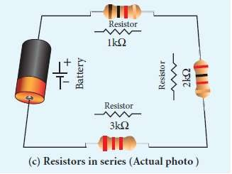

Slide 6
Due to this reason, the current I passing through all the three resistors is the same.
According to Ohm’s law, if same current pass through different resistors of different values, then the potential difference across each resistor must be different
Let V₁, V₂ and V₃ be the potential difference (voltage) across each of the resistors R₁, R₂ and R₃ respectively, then we can write V₁ = IR₁, V₂ = IR₂ and V₃ = IR₃.
But the total voltage V is equal to the sum of voltages across each resistor

Slide 7
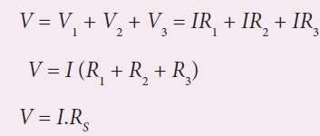

where R_{S} is the equivalent resistance
When several resistances are connected in series, the total or equivalent resistance is the sum of the individual resistances

Slide 8
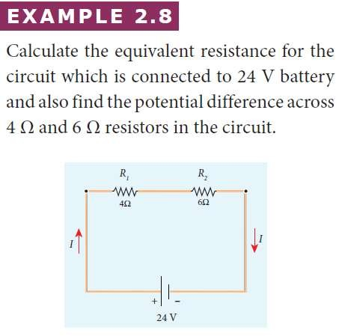

Slide 9
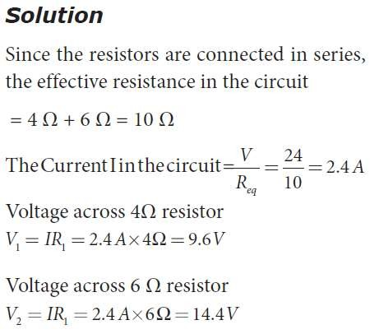

Slide 10
Resistors in parallel
Resistors are in parallel when they are connected across the same potential difference
In this case, the total current I that leaves the battery is split into three separate paths.
Let I₁, I₂ and I₃ be the current through the resistors R₁, R₂ and R₃ respectively.
Due to the conservation of charge, total current in the circuit I is equal to sum of the currents through each of the three resistors.

Slide 11
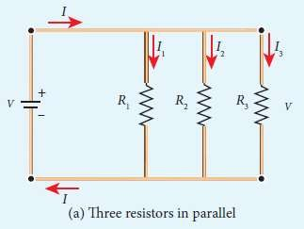

Slide 12
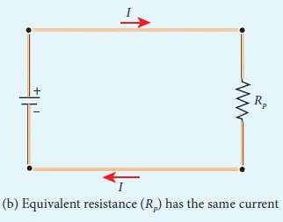

Slide 13
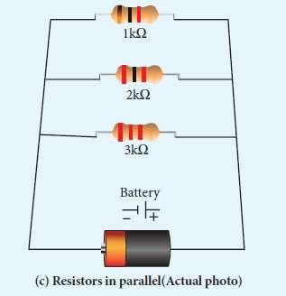

Slide 14


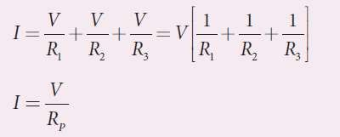
Since the voltage across each resistor is the same, applying Ohm’s law to each resistor, we have
Substituting these values in equation

Slide 15

Here R_{P} is the equivalent resistance of the parallel combination of the resistors.
Thus, when
a number parallel,
of resistors are the sum of the
connected in
reciprocal of the values of resistance of the individual resistor is equal to the reciprocal of the effective resistance of the combination

Slide 16
The value of equivalent resistance in parallel connection will be lesser than each individual resistance.
House hold appliances are always connected in parallel so that even if one is switched off, the other devices could function properly.

Slide 17
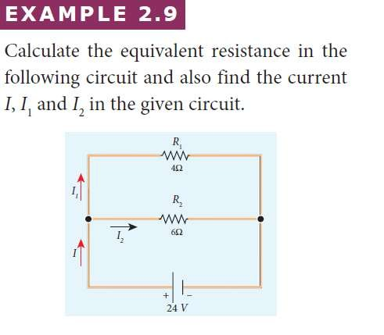

Slide 18
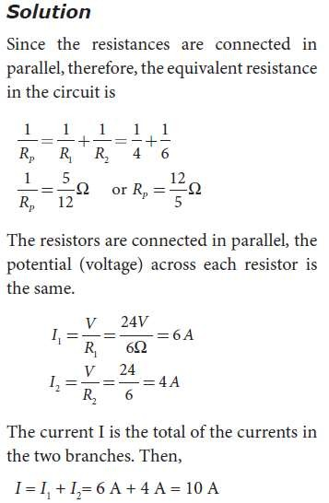

Slide 19
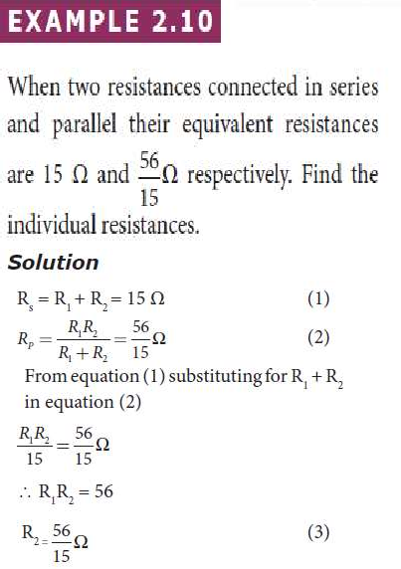

Slide 20
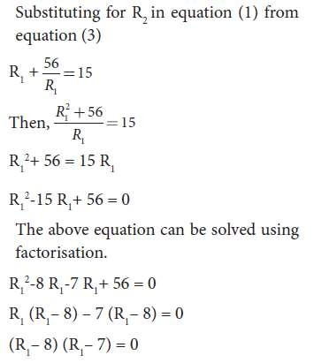

Slide 21
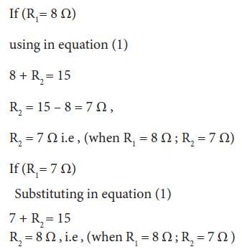

Slide 22
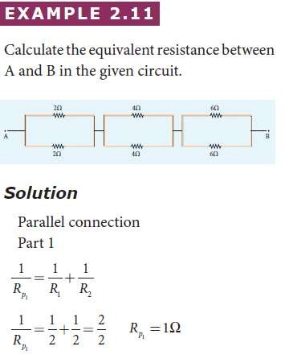

Slide 23
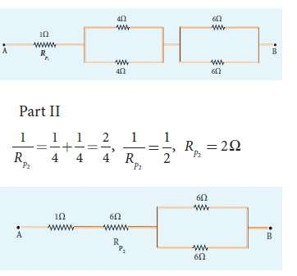

Slide 24
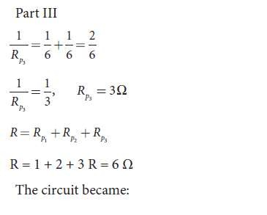

Slide 25
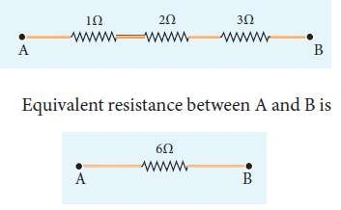

Slide 26
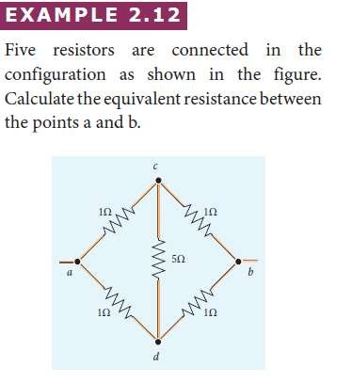

Slide 27
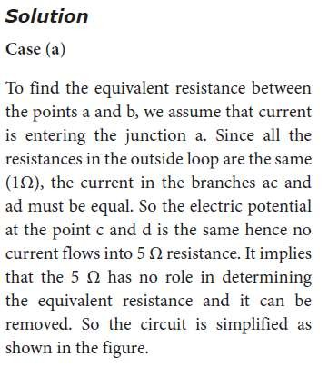

Slide 28
